Slide 1


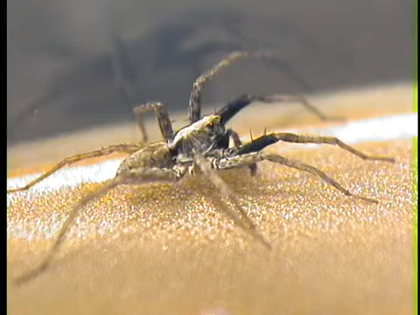
Yihang Park
1st yr Ph.D student in the Hebets Lab @ School of Biological Sciences
Q: How Do Signaler Condition, Receiver Condition, and Signaling Environment
Interact to Affect Mate Choice in Spiders?
Multimodal signal: Visual + Vibratory(seismic)
1. Signals contain information related to male condition
:female(receiver) assess the condition of male(signaler)
2. Signaling environment(channel)
:how effectively the signal travels and is received by female
3. Condition-dependent mate choice:
Female choice may vary depending on the condition as well
Multimodal courtship display of male wolf spider Schizocosa retrorsa
https://www.youtube.com/watch?v=f3xD3T3BYqw

Slide 2
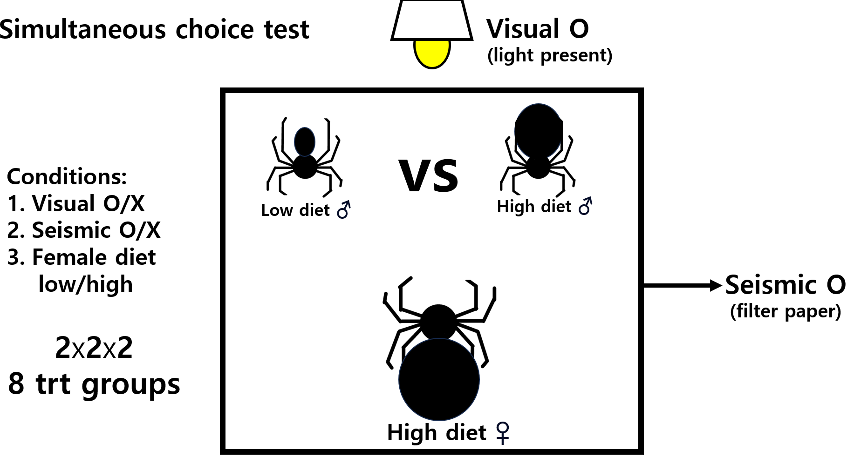
Q: How Do Signaler Condition, Receiver Condition, and Signaling Environment
Interact to Affect Mate Choice in wolf spider (Schizocosa mccooki)?

Slide 3
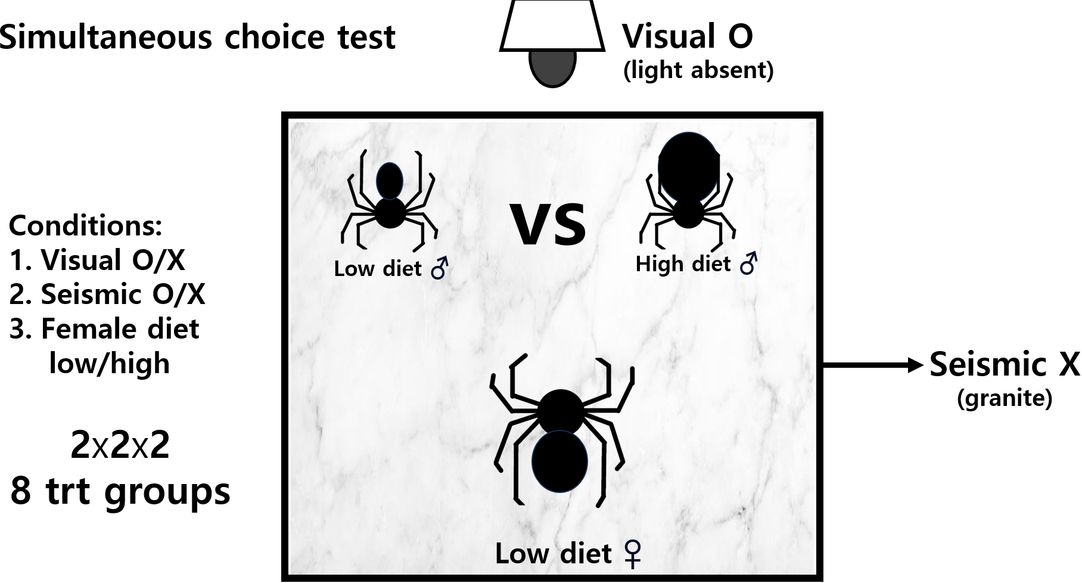
Q: How Do Signaler Condition, Receiver Condition, and Signaling Environment
Interact to Affect Mate Choice in wolf spider (Schizocosa mccooki)?

Slide 4
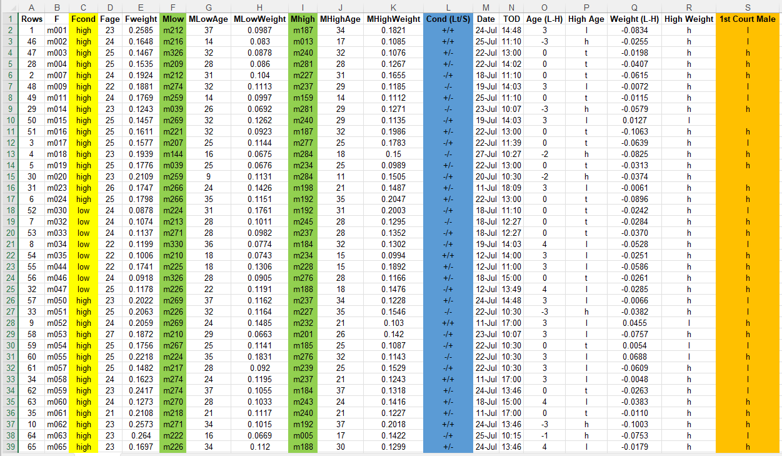
Female ID
&
condition
Male ID
&
condition
Visual/vibratory
Female choice
Nominal logistic regression
In R?
Female diet + male diet + light + vibratory + light * vibratory + male diet*light + … ~ copulation

